Slide 1
Python

Slide 2
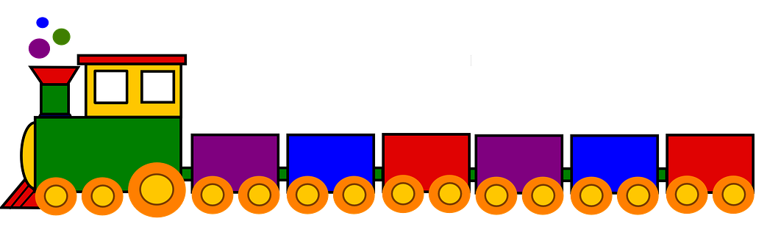
Programming with Python
S
T
R
I
N
G
S
T
U
P
L
E
S
L
I
S
T
S
S
E
T
D
I
C
T
I
O
N
A
R
Y

Slide 3
Strings
Strings in Python have type str
They represent sequence of characters
Python does not have a type corresponding to character.
Strings are enclosed in single quotes(') or double quotes(“)
Both are equivalent
Backslash (\) is used to escape quotes and special characters

Slide 4
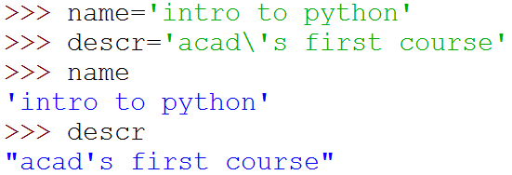

Strings
More readable when print is used

Slide 5
Multiline string:
A= “ “ “ Geeksforgeeks, Noida
An Ed-Tech company,
founded by Mr Sandeep Jain ” ” ”
>>> print(A)
Geeksforgeeks, Noida
An Ed-Tech company,
founded by Mr Sandeep Jain

Slide 6
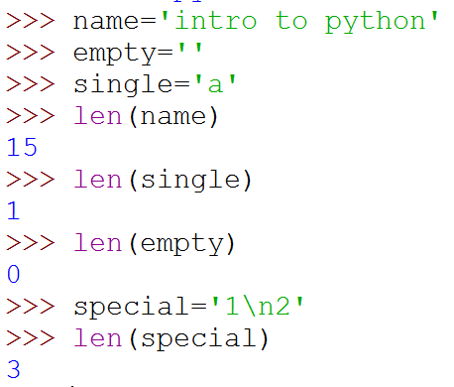
Length of a String
len function gives the length of a string
\n is a single character: the special character representing newline

Slide 7
Concatenate and Repeat
In Python, + and * operations have special meaning when operating on strings
+ is used for concatenation of (two) strings
* is used to repeat a string, an int number of time
Operator Overloading

Slide 8

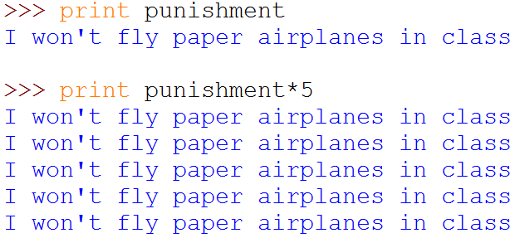
Concatenate and Repeat

Slide 9
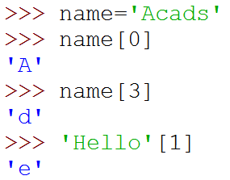
Indexing
Strings can be indexed
First character has index 0

Slide 10
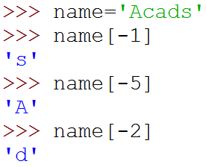
Indexing
Negative indices start counting from the right
Negatives indices start from -1
-1 means last, -2 second last, ...

Slide 11
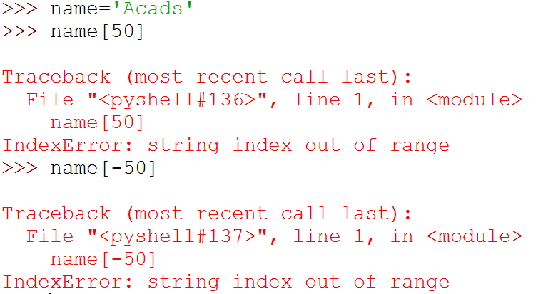
Indexing
Using an index that is too large or too small results in “index out of range” error

Slide 12
Looping Through a String
Since strings are arrays, we can loop through the characters in a string, with a for loop.
Example
Loop through the letters in the word “Hello World!”:
for x in "Hello World!": >>> print(x)
H
e
l
l
o
…..

Slide 13
Membership role : in/ not in
Check String
To check if a certain phrase or character is present in a string, we can use the keyword in.
Example
Check if “best" is present in the following text:
>>>txt = “Honesty is the best policy!"
>>>print(“best" in txt)
True

Slide 14
Slicing
To obtain a substring
s[start:end] means substring of s starting at index start and ending at index end-1
s[0:len(s)] is same as s
Both start and end are optional
If start is omitted, it defaults to 0
If end is omitted, it defaults to the length of string
s[:] is same as s[0:len(s)], that is same as s

Slide 15
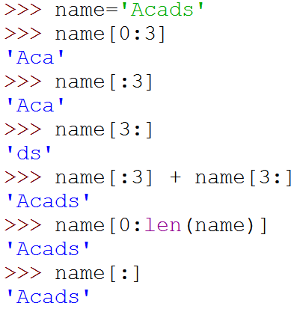
Slicing

Slide 16
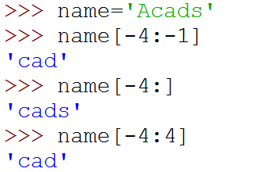
More Slicing
Understanding Indices for slicing
A | c | a | d | s
0 | 1 | 2 | 3 | 4
-5 | -4 | -3 | -2 | -1
5

Slide 17
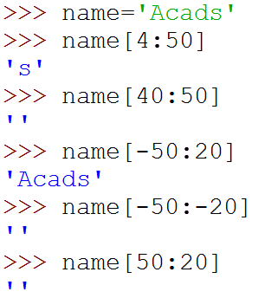

Out of Range Slicing
A | c | a | d | s
0 | 1 | 2 | 3 | 4
-5 | -4 | -3 | -2 | -1
Out of range indices are ignored for slicing
when start and end have the same sign, if start >=end, empty slice is returned
Why?

Slide 18
Modifying String
a = “Hello, World!”
b = “Hello World! ”
a.upper() #Upper case conversion
a.lower() #Lower case Conversion
a.strip() #Removes all whitespaces from string from both the ends of the string
a.replace("H","J", [count])
a.split(",") #splits the string based on separator

Slide 19
f-strings
A formatted string literal or f-string is a string literal that is prefixed with 'f' or 'F'.
These strings may contain replacement fields, which are expressions delimited by curly braces { }.
While other string literals always have a constant value, formatted strings are really expressions evaluated at run time.
>>> name = "Fred“
>>> f"He said his name is {name!r}.“
"He said his name is 'Fred'.“
>>> f"He said his name is {repr(name)}." # repr() is equivalent to !r“
He said his name is 'Fred'.“

Slide 20
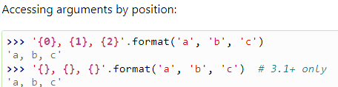
Custom String Formatting
The built-in string class provides the ability to do complex variable substitutions and value formatting via the format() method
Three conversion flags are currently supported: '!s' which calls str() on the value, '!r' which calls repr() and '!a' which calls ascii().
Some examples:
"Harold's a clever {0!s}" # Calls str() on the argument first
"Bring out the holy {name!r}" # Calls repr() on the argument first
"More {!a}" # Calls ascii() on the argument first

Slide 21


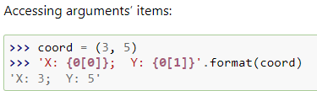
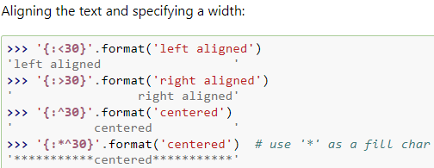
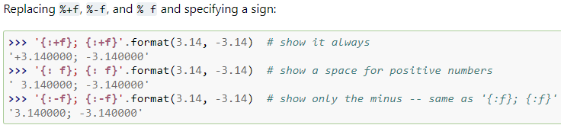

Slide 22
More Functions on Python String

Slide 23
What is the output of the code shown below?
'{a}{b}{a}'.format(a='hello', b='world')
'hello world’
'helloʼ 'world' ʻhello‘
'helloworldhello‘
'helloʼ ʻhelloʼ ʻworld'

Slide 24
2. What does this command do str[ ::- 1]
Selects only the last character of str
Selects full string except the last character
Reverses the str
Select the -1th character

Slide 25
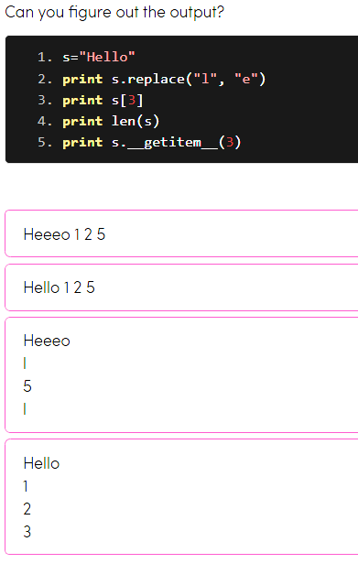

Slide 26
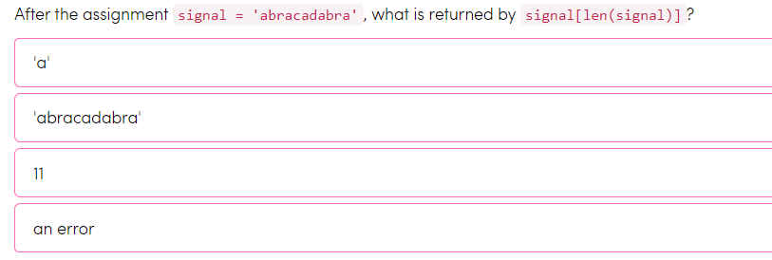

Slide 27
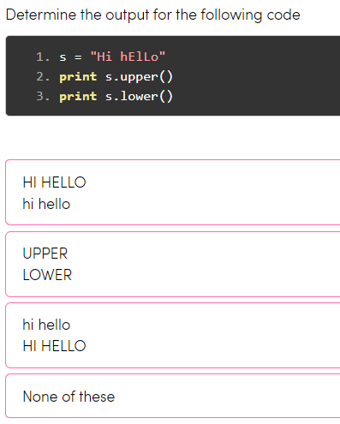

Slide 28
Python List
Python list is a data structure which is used to store various types of data.
In Python, lists are mutable i.e., Python will not create a new list if we modify an element of the list.
It works as a container that holds other objects in a given order. We can perform various operations like insertion and deletion on list.
A list can be composed by storing a sequence of different type of values separated by commas.
Python list is enclosed between square([]) brackets and elements are stored in the index basis with starting index 0.
It can have any number of items and they may be of different types (integer, float, string etc.).

Slide 29
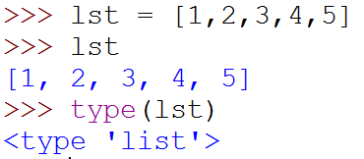
Lists
Ordered sequence of values
Written as a sequence of comma-separated values between square brackets
Values can be of different types
usually the items all have the same type

Slide 30
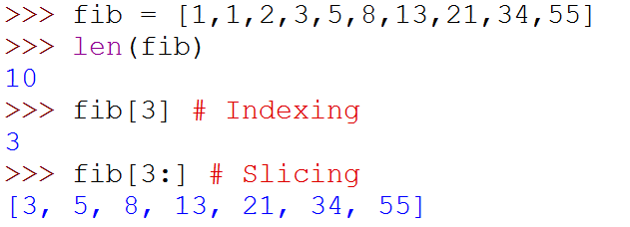
Lists
List is also a sequence type
Sequence operations are applicable

Slide 31
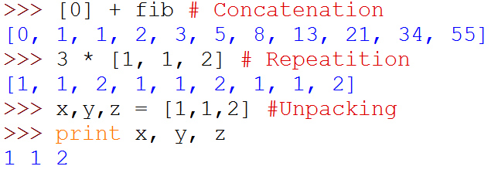
Lists
List is also a sequence type
Sequence operations are applicable
Repetition
(
)

Slide 32
Nested List
Also, a list can even have another list as an item. This is called nested list.
# nested list
my_list = ["mouse", [8, 4, 6], ['a']]

Slide 33
List Index
We can use the index operator [] to access an item in a list. Index starts from 0. So, a list having 5 elements will have index from 0 to 4.
Trying to access an element other than that this will raise an IndexError. The index must be an integer. We can't use float or other types, this will result into TypeError.
Nested list are accessed using nested indexing.

Slide 34
Negative Indexing & Slice
Negative indexing Python allows negative indexing for its sequences. The index of -1 refers to the last item, -2 to the second last item and so on.
Slice List in Python
We can access a range of items in a list by using the slicing operator (colon).
List are mutable, meaning, their elements can be changed unlike string or tuple.
We can use assignment operator (=) to change an item or a range of items.

Slide 35
append() and extend()
We can add one item to a list using append() method or add several items using extend() method.
We can also use + operator to combine two lists. This is also called concatenation.
The * operator repeats a list for the given number of times.
We can delete one or more items from a list using the keyword del. It can even delete the list entirely.

Slide 36
remove(), pop() & clear()
We can use remove() method to remove the given item or pop() method to remove an item at the given index.
The pop() method removes and returns the last item if index is not provided. This helps us implement lists as stacks (LIFO data structure).
We can also use the clear() method to empty a list.
List Membership Test We can test if an item exists in a list or not, using the keyword ‘in/ not in’.

Slide 37
Append() | Add an element to the end of the list
Extend() | Add all elements of a list to another list
Insert() | Insert an item at the defined index
Remove() | Removes an item from the list
Pop() | Removes and returns an element at the given index
Clear() | Removes all items from the list
Index() | Returns the index of the first matched item
Count() | Returns the count of the number of items passed as an argument
Sort() | Sort items in a list in ascending order
Reverse() | Reverse the order of items in the list
copy() | Returns a copy of the list

Slide 38
reduce() | apply a particular function passed in its argument to all of the list elements stores the intermediate result and only returns the final summation value
sum() | Sums up the numbers in the list
ord() | Returns an integer representing the Unicode code point of the given Unicode character
cmp() | This function returns 1 if the first list is “greater” than the second list
max() | return maximum element of a given list
min() | return minimum element of a given list
all() | Returns true if all element is true or if the list is empty
any() | return true if any element of the list is true. False, if the list is empty.
len() | Returns length of the list or size of the list
enumerate() | Returns enumerate object of the list
accumulate() | apply a particular function passed in its argument to all of the list elements returns a list containing the intermediate results
filter() | tests if each element of a list is true or not
map() | returns a list of the results after applying the given function to each item of a given iterable
lambda() | This function can have any number of arguments but only one expression, which is evaluated and returned.

Slide 39
Loop Through a List
thislist =["apple", "banana", "cherry"] for x in thislist: print(x)
Loop Through the Index Numbers
thislist = ["apple", "banana", "cherry"] for i in range(len(thislist)): print(thislist[i])
Shorthand for loop
thislist = ["apple", "banana", "cherry"] [print(x) for x in thislist]

Slide 40
>>> colors = ["red", "green", "burnt sienna", "blue"]
>>> colors[2]
What is the output of the colors[2] expression?
'blue'
It causes a run-time error.
'red'
'green'
'burnt sienna'

Slide 41
>>> colors = ["red", "green", "burnt sienna", "blue"]
>>> "yellow" in colors
What is the result of the yellow in colors expression?
3
4
False
ValueError: 'yellow' is not in list

Slide 42
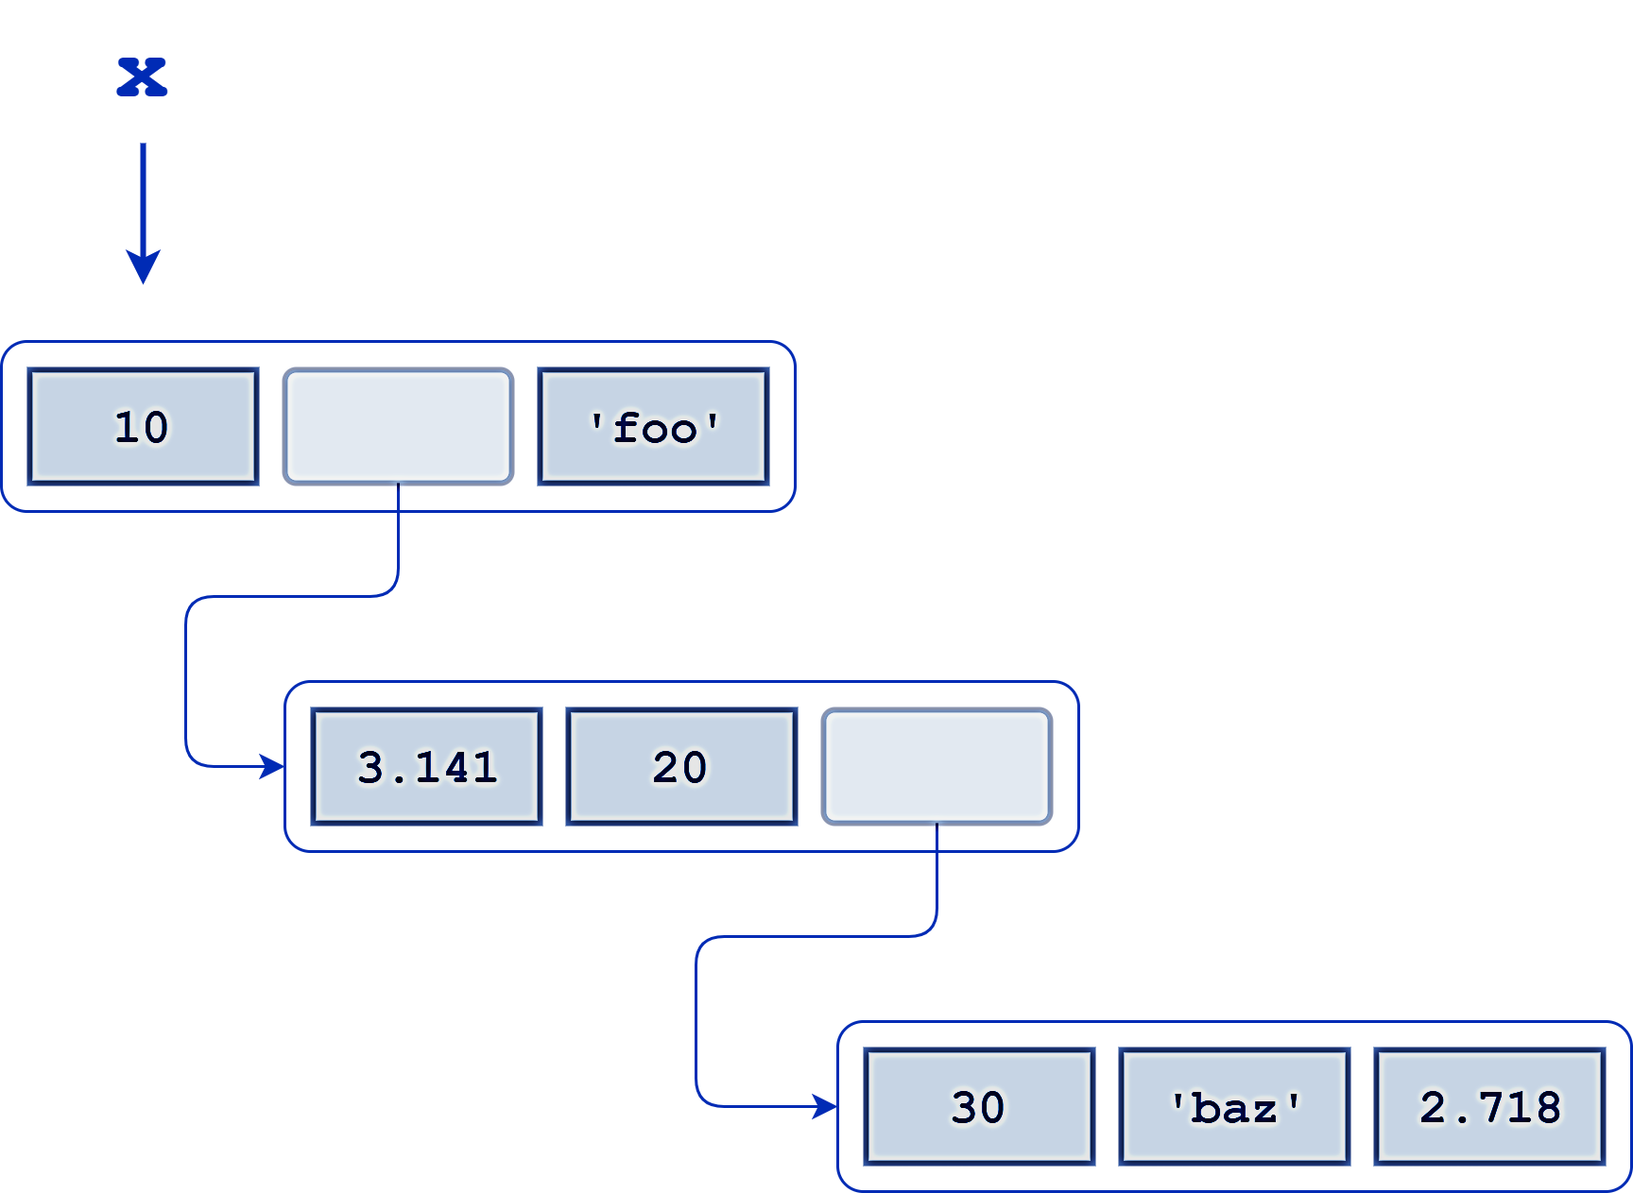
Consider the following nested list definition:
x = [10, [3.141, 20, [30, 'baz', 2.718]], 'foo']
A schematic for this list is shown below:
Nest list example
What is the expression that returns the 'z' in 'baz'?
X[1][2][1][2]

Slide 43
Consider the following nested list definition:
x = [10, [3.141, 20, [30, 'baz', 2.718]], 'foo']
A schematic for this list is shown below:
Nest list example
What is the expression that returns the list ['baz', 2.718]?
X[1][2][1:]
Or
X[1][2][1:3]

Slide 44
Which of the following are true of Python lists?
There is no conceptual limit to the size of a list
All elements in a list must be of the same type
A list may contain any type of object except another list
These represent the same list:
['a', 'b', 'c']
['c', 'a', 'b']
A given object may appear in a list more than once

Slide 45
You have a list A defined as follows:
A = [1, 2, 7, 8]
Write a Python statement using slice assignment that will fill in the missing values so that a equals [1, 2, 3, 4, 5, 6, 7, 8].
a[2:2] = [3, 4, 5, 6]

Slide 46
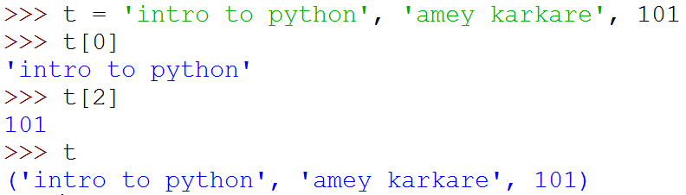
Tuples
A tuple consists of a number of values separated by commas
Empty and Singleton Tuples

Slide 47
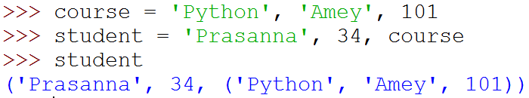

Nested Tuples
Tuples can be nested
Note that course tuple is copied into student.
Changing course does not affect student

Slide 48
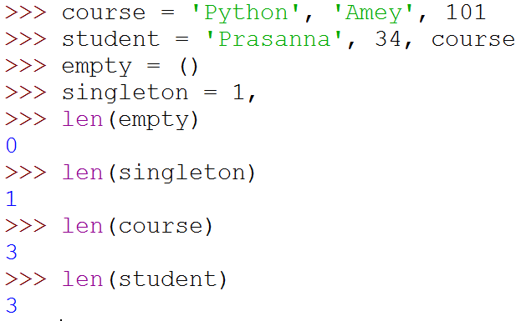
Length of a Tuple
len function gives the length of a tuple

Slide 49
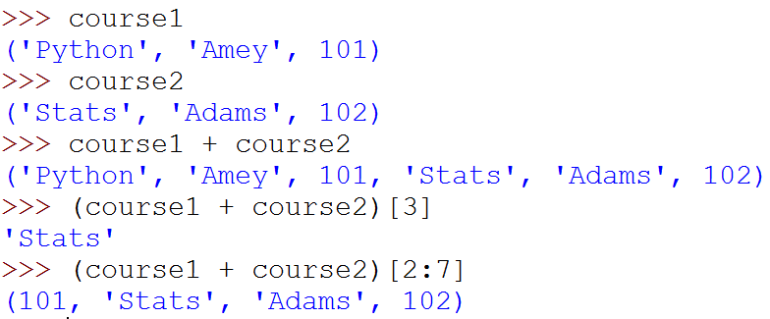
More Operations on Tuples
Tuples can be concatenated, repeated, indexed and sliced

Slide 50
Unpacking Sequences
Strings and Tuples are examples of sequences
Indexing, slicing, concatenation, repetition operations applicable on sequences
Sequence Unpacking operation can be applied to sequences to get the components
Multiple assignment statement
LHS and RHS must have equal length

Slide 51
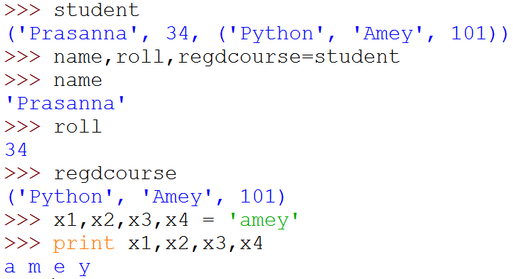
Unpacking Sequences
(
)

Slide 52
Mutable and Immutable Types
Tuples and List types look very similar
However, there is one major difference: Lists are mutable
Contents of a list can be modified
Tuples and Strings are immutable
Contents can not be modified

Slide 53
Summary of Sequences
Operation | Meaning
seq[i] | i-th element of the sequence
len(seq) | Length of the sequence
seq1 + seq2 | Concatenate the two sequences
num*seq seq*num | Repeat seq num times
seq[start:end] | slice starting from start, and ending at end-1
e in seq | True if e is present is seq, False otherwise
e not in seq | True if e is not present is seq, False otherwise
for e in seq | Iterate over all elements in seq (e is bound to one element per iteration)
Sequence types include String, Tuple and List.
Lists are mutable, Tuple and Strings immutable.

Slide 54
Summary of Sequences
For details and many useful functions, refer to:
https://docs.python.org/3.2/tutorial/datastructures.html

Slide 55
How do you assign a tuple of length 1 to the variable a?
a = (1,)
a = [1]
a = tuple(1)
a = 1
a = 1,

Slide 56
Suppose you have the following tuple definition:
t = ('foo', 'bar', 'baz')
Which of the following statements replaces the second element ('bar') with the string 'qux':
It’s a trick question—tuples can’t be modified.
t(1) = 'qux'
t[1] = 'qux'
t[1:1] = 'qux'

Slide 57
Consider this assignment statement:
a, b, c = (1, 2, 3, 4, 5, 6, 7, 8, 9)[1::3]
Following execution of this statement, what is the value of b:
4
5
2
6

Slide 58
Assume x and y are assigned as follows:
x = 5
y = -5
What is the effect of this statement:
x, y = (y, x)[::-1]
The values of x and y are swapped
Both x and y are -5
Both x and y are 5
The values of x and y are unchanged

Slide 59
Programming with Python
Sets and Dictionaries

Slide 60
Sets
An unordered collection with no duplicate elements
Supports
membership testing
eliminating duplicate entries
Set operations: union, intersection, difference, and symmetric difference.

Slide 61
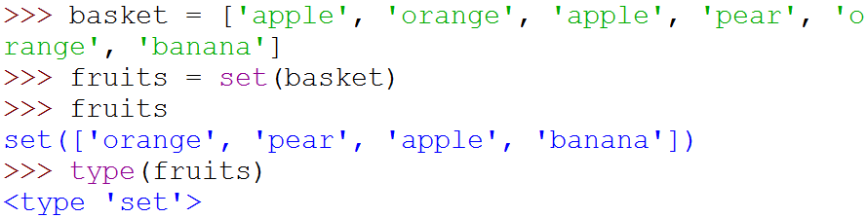
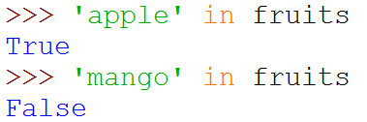
Sets
{
}
Create a set from
a sequence

Slide 62
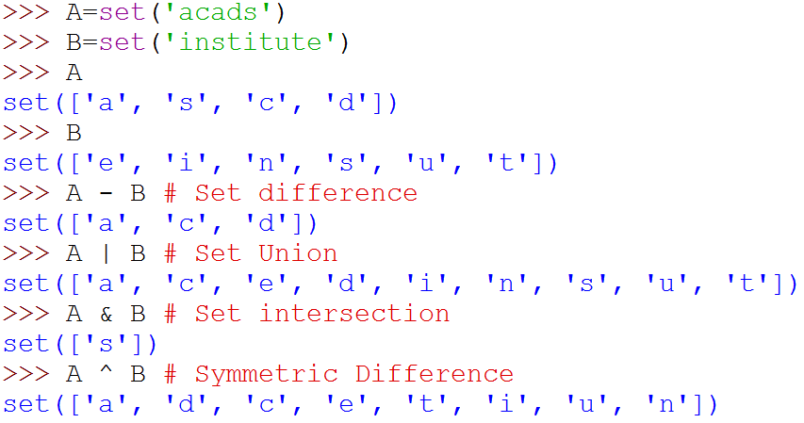
Set Operations
{
}
{
}
{
}
{
}
{
}

Slide 63
Set functions
add() # thisset.add(“abc”)
update( ) # thisset.update(thatset)
The object in the update() method does not have to be a set, it can be any iterable object (tuples, lists, dictionaries etc.)
remove( ) # thisset.remove(“abc”)
discard() # thisset.discard("abc")
thisset.pop()
thisset.clear()
del thisset

Slide 64
Method | Description
add() | Adds an element to the set
clear() | Removes all the elements from the set
copy() | Returns a copy of the set
difference() | Returns a set containing the difference between two or more sets
difference_update() | Removes the items in this set that are also included in another, specified set
discard() | Remove the specified item
intersection() | Returns a set, that is the intersection of two other sets
intersection_update() | Removes the items in this set that are not present in other, specified set(s)
isdisjoint() | Returns whether two sets have a intersection or not
issubset() | Returns whether another set contains this set or not
issuperset() | Returns whether this set contains another set or not
pop() | Removes an element from the set
remove() | Removes the specified element
symmetric_difference() | Returns a set with the symmetric differences of two sets
symmetric_difference_update() | inserts the symmetric differences from this set and another
union() | Return a set containing the union of sets
update() | Update the set with the union of this set and others

Slide 65
Which of the following are true for objects of Python’s set type:
The order of elements in a set is significant.
Sets are mutable.
A given element can’t appear in a set more than once.
A set may contain elements that are mutable.

Slide 66
You have a set s defined as follows: s = {100, 200, 300}
Which one of the following statements does not correctly produce the union of s and the set {300, 400, 500}:
s | set([300, 400, 500])
s | {300, 400, 500}
s.union({300, 400, 500})
s.union([300, 400, 500])
s | [300, 400, 500]

Slide 67
What is the result of this statement:
{'b', 'a', 'r'} & set('qux')
{}
{'b', 'r', 'a'}
set()
{'q', 'r', 'x', 'u', 'b', 'a'}

Slide 68
What is the result of this statement:
{1, 2, 3, 4, 5} - {3, 4} ^ {5, 6, 7}
{3, 4, 5, 6, 7}
set()
{1, 2, 6, 7}
{1, 2}

Slide 69
Suppose a set s is defined as follows:
s = {'foo', 'bar', 'baz', 'qux'}
Which of the following remove element 'bar' from s:
s.difference_update({'bar'})
s.discard('bar')
s &= {'foo', 'baz', 'qux'}
del s['bar']
s -= {'bar'}
s.pop()

Slide 70
Dictionaries
Unordered set of key:value pairs,
Keys have to be unique and immutable
Key:value pairs enclosed inside curly braces {...}
Empty dictionary is created by writing {}
Dictionaries are mutable
add new key:value pairs,
change the pairing
delete a key (and associated value)

Slide 71
Operations on Dictionaries
Operation | Meaning
len(d) | Number of key:value pairs in d
d.keys() | List containing the keys in d
d.values() | List containing the values in d
k in d | True if key k is in d
d[k] | Value associated with key k in d
d.get(k, v) | If k is present in d, then d[k] else v
d[k] = v | Map the value v to key k in d (replace d[k] if present)
del d[k] | Remove key k (and associated value) from d
for k in d | Iterate over the keys in d

Slide 72
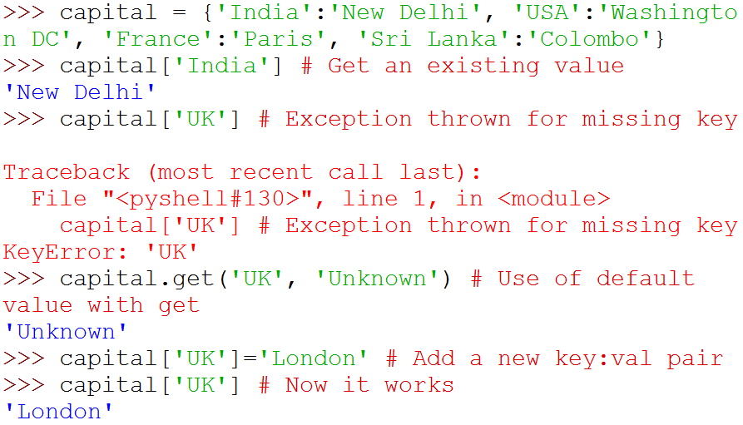
Operations on Dictionaries

Slide 73
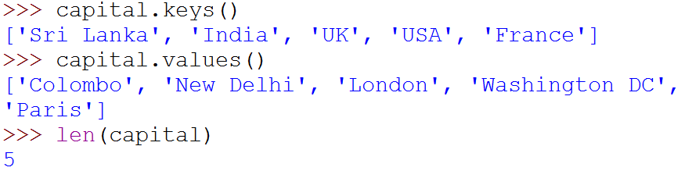
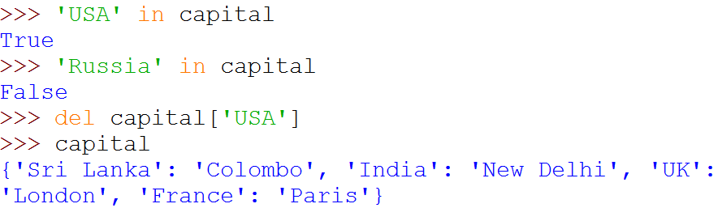
Operations on Dictionaries

Slide 74
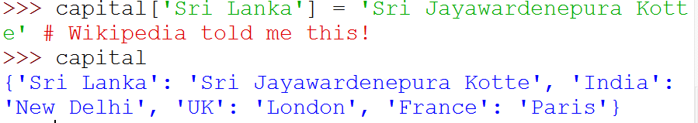
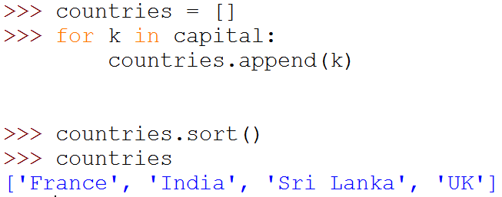
Operations on Dictionaries
# Remember: for ... in iterates over keys only
# Sort values in a list

Slide 75
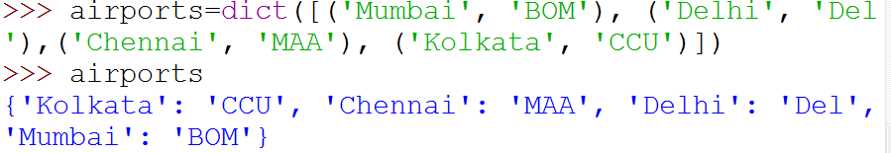
Dictionary Construction
The dict constructor: builds dictionaries directly from sequences of key-value pairs

Slide 76
Method | Description
clear() | Removes all the elements from the dictionary
copy() | Returns a copy of the dictionary
fromkeys() | Returns a dictionary with the specified keys and value
get() | Returns the value of the specified key
items() | Returns a list containing a tuple for each key value pair
keys() | Returns a list containing the dictionary's keys
pop() | Removes the element with the specified key
popitem() | Removes the last inserted key-value pair
setdefault() | Returns the value of the specified key. If the key does not exist: insert the key, with the specified value
update() | Updates the dictionary with the specified key-value pairs
values() | Returns a list of all the values in the dictionary

Slide 77
Which of the following are true of Python dictionaries:
All the keys in a dictionary must be of the same type.
Dictionaries can be nested to any depth.
Items are accessed by their position in a dictionary.
Dictionaries are mutable.
A dictionary can contain any object type except another dictionary.
Dictionaries are accessed by key.

Slide 78
Write the Python code that prints out Captain Kirk’s email address from the employee dictionary below:
employee = {
"id": 1701,
"name": "James T Kirk",
"email": "jtkirk@starfleet.com",
"position": "captain",
}
​
# Add your code below:
print(employee["email"])

Slide 79
Which Python code could replace the ellipsis (...) below to get the following output? (Select all that apply.)
>>> captains = {
>>> "Enterprise": "Picard",
>>> "Voyager": "Janeway",
>>> "Defiant": "Sisko",
>>> }
>>> ...
Enterprise Picard
Voyager Janeway
Defiant Sisko
for ship in captains:
print(ship, captains[ship])
B. for ship, captain in captains.items():
print(ship, captain)
C. for ship in captains:
print(ship, captains)

Slide 80
Which of the following statements about this nested dictionary are true? (Select all that apply.)
If you want to access the nested values, then you need to split the dictionary.
You can access the nested values directly by chaining square brackets ([]).
The values for "California", "New York", and "Texas" are all dictionaries.
The syntax isn’t valid.
states = {
"California": {
"capital": "Sacramento",
"flower": "California Poppy"
},
"New York": {
"capital": "Albany",
"flower": "Rose"
},
"Texas": {
"capital": "Austin",
"flower": "Bluebonnet"
}
}

Slide 81
Which of the following lines of code will create an empty dictionary named captains?
type(captains)
captains = {dict}
captains = {}
captains.dict()

Slide 82
Now you have your empty dictionary named captains. It’s time to add some data!
Specifically, you want to add the key-value pairs "Enterprise": "Picard", "Voyager": "Janeway", and "Defiant": "Sisko".
Which of the following code snippets will successfully add these key-value pairs to the existing captains dictionary?
A. captains["Enterprise"]: "Picard"
captains["Voyager"]: "Janeway"
captains["Defiant": "Sisko"
B. captains{"Enterprise" = "Picard"}
captains{"Voyager" = "Janeway"}
captains{"Defiant" = "Sisko"}
C. captains = {
"Enterprise": "Picard",
"Voyager": "Janeway",
"Defiant": "Sisko",
}
D. captains["Enterprise"] = "Picard"
captains["Voyager"] = "Janeway"
captains["Defiant"] = "Sisko"

Slide 83
PYQ GATE DA-2024

Slide 84
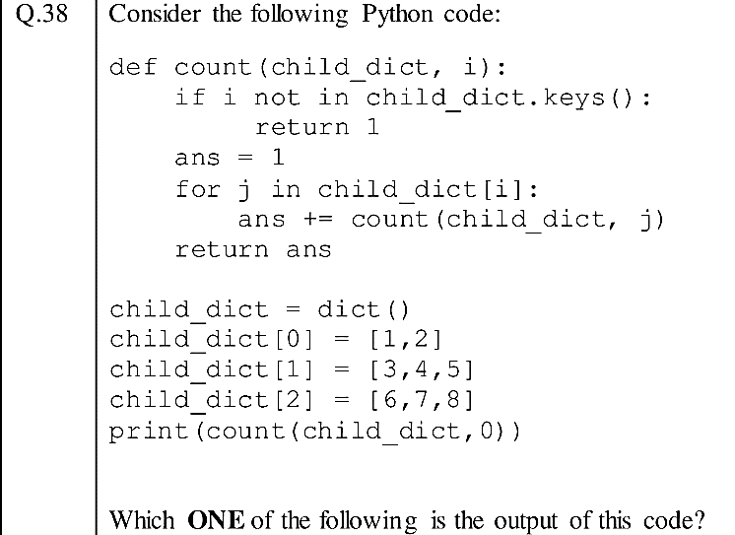
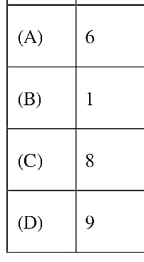
Gate DA -2024

Slide 85
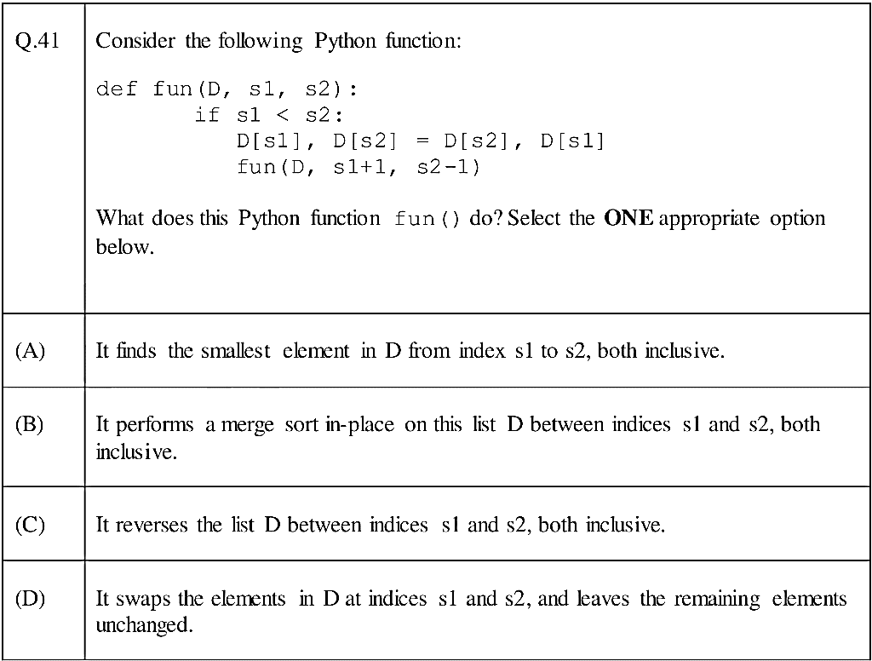
Gate DA -2024

Slide 86

Any question?

